Slide 1

Pharma Performance Insights (2022–2025)
A Story of Growth, Trends, and Performance Excellence
Built in Power BI | Arima Bhattacharya

Slide 2
Our Analytical Journey
Purpose & Scope
Methodology
This comprehensive analysis evaluates revenue performance, target achievements, and team effectiveness across a critical Four-year transformation period (2022–2025).
Leveraging Power BI's advanced analytics capabilities, we've uncovered actionable insights across multiple dimensions.
Key areas examined:
Our focus encompasses growth trajectories, product line dynamics, seasonal behaviour patterns, and strategic channel performance.
Revenue trends and year-over-year growth patterns
Top and lowest performing product categories
Seasonal fluctuations and quarterly momentum
Team and individual performance benchmarks

Slide 3
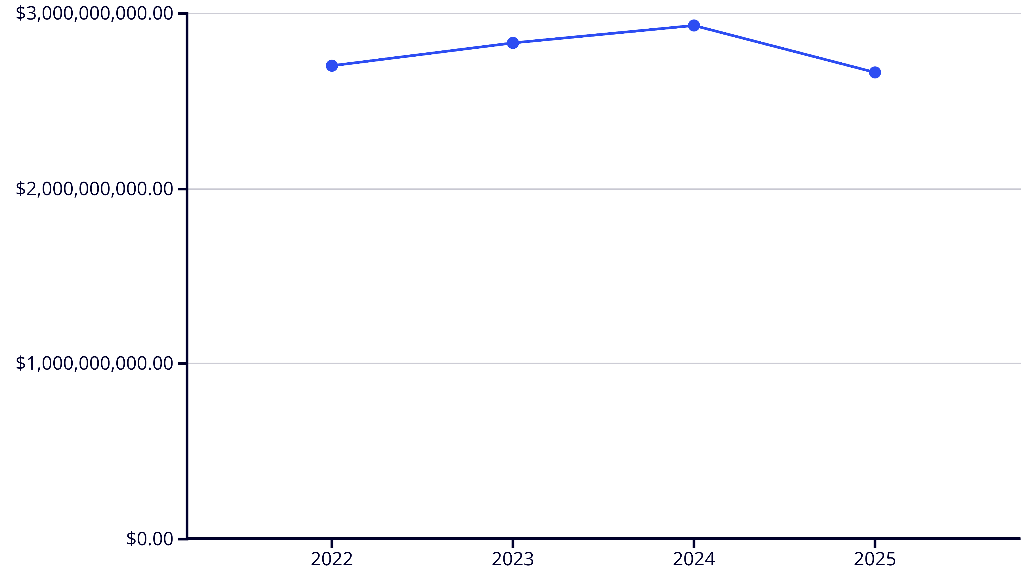
Revenue Evolution: From Growth to Stabilisation
2022
2023
2024
2025
$2.7B
$2.83B
$2.93B
$2.66B
Strong foundation year establishing baseline performance
5% growth demonstrating
Market expansion
Peak performance with 3.5%
Increase
9% decline attributed to reduced hospital volumes

Slide 4
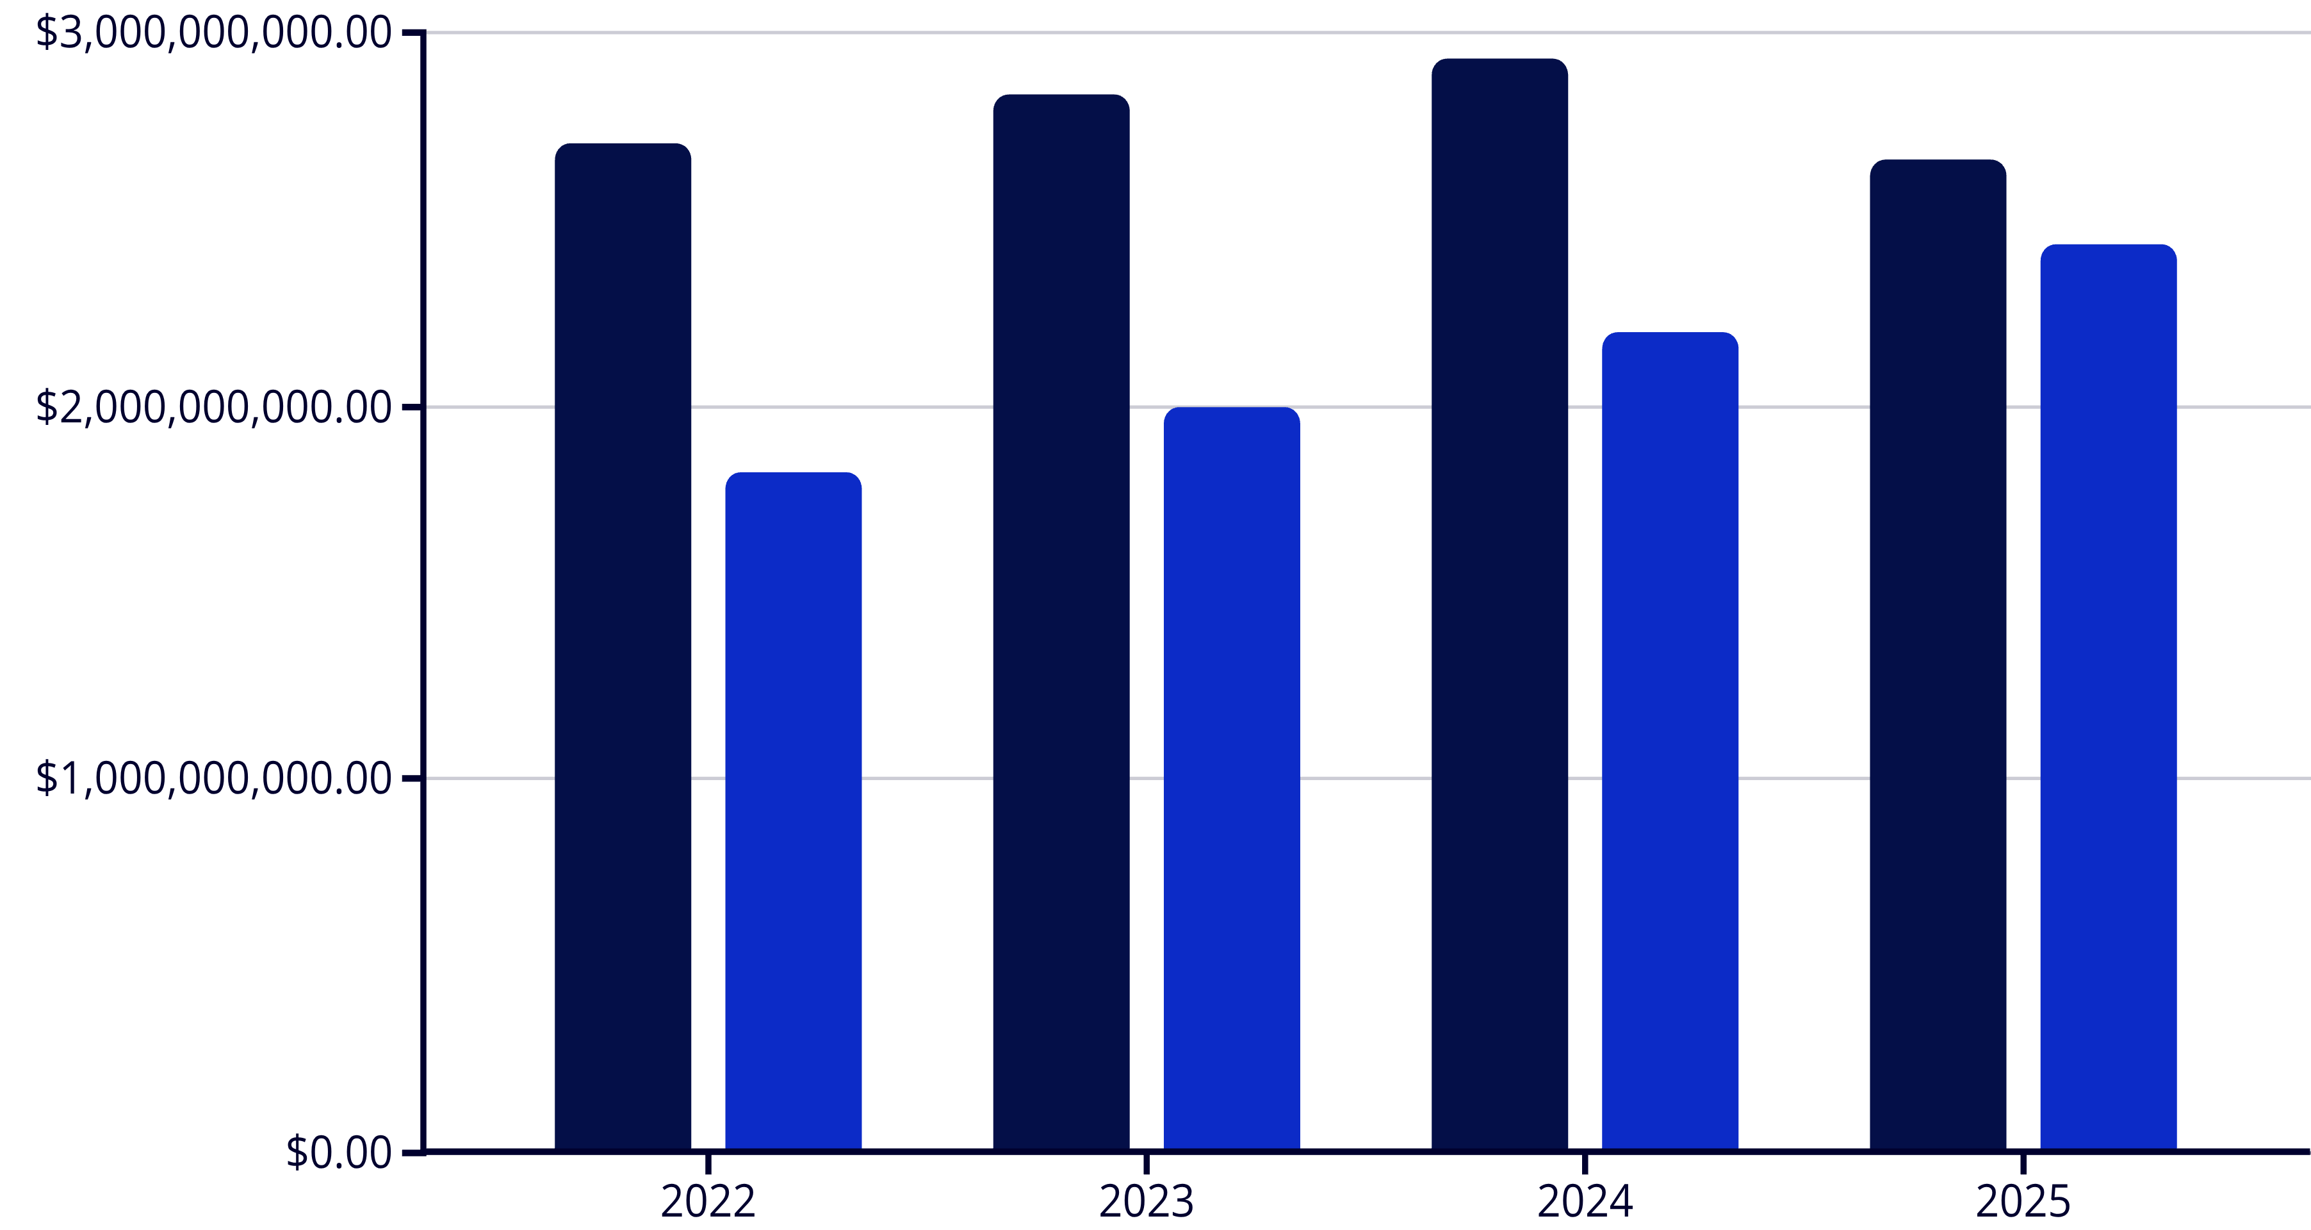
Consistent Outperformance: Targets vs Actuals
Four consecutive years of exceeding revenue targets showcase exceptional commercial execution and strategic planning accuracy.
Actual Revenue
Target Revenue
148%
141%
133%
109%
2022 Achievement
2023 Achievement
2024 Achievement
2025 Achievement
Exceptional first-year performance
Sustained excellence
Consistent goal alignment
Above target despite headwinds

Slide 5

Product Portfolio Dynamics
Shifting Leadership Across Categories
1
2022: Antiseptics Lead
Antiseptics dominated revenue streams whilst Antimalarials lagged significantly behind other categories.
2
2023: Analgesics Rise
Pain management products overtook antiseptics as market demand shifted. Antimalarials remained lowest performers.
3
2024: Dual Leadership
Analgesics and Antiseptics shared top position. Mood Stabilisers emerged as new lowest performer, replacing Antimalarials.
4
2025: Preventive Focus
Antimalarials achieved highest target percentage, signalling strategic pivot toward preventive care. Analgesics declined to lowest position.
Strategic insight: Product dominance evolved from general antiseptics → pain management → preventive healthcare, reflecting changing market needs and prescribing patterns.

Slide 6


Channel Performance: Pharmacy Dominance
2022–2023
Retail Leadership
Retail pharmacy achieved highest contribution whilst private hospitals underperformed significantly.
2024–2025
Stable Mix
Pharmacy Institution and Retail maintained ~50% combined share with government hospitals showing consistent improvement.
Key takeaway: Channel mix stability suggests mature distribution strategy, though private hospital opportunity remains largely untapped.
Distribution Insights
Pharmacy channels (Institution + Retail) consistently drive
approximately 50% of total revenue,
demonstrating the critical importance of retail partnerships.
Government hospital sales exhibited steady growth throughout the
period, whilst private hospital
engagement remained the weakest channel across all years.

Slide 7

Quarterly Momentum: 2024 vs 2025
Quarterly performance reveals significant volatility patterns and a remarkable Q4 2025 recovery following mid-year challenges.
Q1 Performance
1
2024: £688.7M | 2025: £578.1M
16% year-over-year decline. Antiseptics led both years with notable February spikes in revenue.
Q2 Volatility
2
2024: £642.4M | 2025: £562.9M
12% decrease. Analgesics dominated with pronounced May-June fluctuations
Q3 Decline
3
2024: £924.0M | 2025: £702.8M
Steepest 24% drop. Both Analgesics and Antiseptics shared leadership. August 2024 showed
exceptional surge.
Q4 Rebound
4
2024: £675.8M | 2025: £815.9M
Strong 21% recovery driven by pharmacy channel boost. Analgesics regained dominance with
November revival.

Slide 8


People Power Behind Performance
Team Excellence and Individual Achievement
Individual Excellence
2022 Top Performer
Employee SN22597 set exceptional baseline standards
2023 Leader
SN21998 drove growth momentum
2024 Dual Excellence
SN21720 & SN21656 shared top honours
2025 Champion
SN22310 led recovery efforts
Team Performance
Delta team emerged as the consistent backbone of sales success, maintaining top
position across all four years (2022–2025).
Charlie team ranked lowest in 2022, whilst Alfa and Bravo teams struggled in 2024–2025, indicating potential areas for targeted development and best practice sharing.
Sustained excellence from Delta team combined with emerging talent each year
demonstrates robust succession planning and performance culture.

Slide 9

Seasonal Patterns and Monthly Fluctuations
Multi-year analysis reveals clear cyclical patterns essential for demand planning, inventory optimisation, and strategic resource allocation.
2022 Pattern
1
February peaks contrasted with April and October dips, establishing baseline seasonality.
2
2023 Growth
Strong March-June performance with notable October surge indicating mid-year and autumn demand.
2024 Volatility
3
High fluctuation year with exceptional February and August spikes creating forecasting complexity.
4
2025 Stabilisation
More predictable patterns emerged with Q4 recovery, suggesting maturing demand cycles.
Historical Peaks
Volatile Quarters
Regional Leaders
February (2022, 2024)
Q1 and Q3 historically demonstrate largest month-over-month fluctuations, requiring enhanced planning focus.
2022: Ludwigshafen2023: Aurich2024: Butzbach2025: Baesweiler
March & June (2023)
August (2024)
November (2025)

Slide 10
Strategic Roadmap Forward
From Performance Analysis to Predictive Action
Key Achievements
Strategic Priorities
Growth Opportunities
Revenue growth 2022–2024 (£2.7B → £2.93B)
Diversify hospital channel engagement
Private hospital tailored contracts
Revitalise underperforming product lines
Regional investment (Baesweiler focus)
Four consecutive years exceeding targets (109%–148%)
Replicate Delta team best practices
Seasonal optimisation strategies
Enhance predictive analytics capabilities
Realistic quarterly goal alignment
Delta team sustained sales leadership
Product evolution toward preventive care
Immediate Actions
Long-term Vision
Deploy Power BI predictive models for month-over-month trend forecasting
Position the organisation for sustainable growth through data-driven decision-making, channel diversification, and continuous performance optimisation.
Develop targeted private hospital engagement programmes
Implement Delta team methodology across underperforming zones
The 2025 stabilisation signals market maturity—our opportunity to lead through strategic innovation.

